Slide 1


COMSATS University Islamabad, Attock Campus
Vehicle Classification
By
Mubashir Ali
(fa21-bcs-009)
Hasnain Ali
(fa21-bcs-005)

Slide 2
Introduction:
Vehicle Classification
Objective:
Develop a classification model to identify and categorize images of Vehicles into three classes: Auto, Car, and Motorcycle.
Classes:
Three distinct classes for classification: Auto, Car, and Motorcycle.
Model Selection:
Utilizing a Convolutional Neural Network (CNN) architecture for image classification tasks.
The dataset is divided into training and validation sets, and a convolutional neural network (CNN) model is trained on these sets.

Slide 3
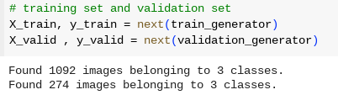
Dataset:
Vehicle Classification
Data Preprocessing
To prepare the dataset for model training, a series of preprocessing steps are applied. These include resizing images to a standard size, normalization of pixel values to the [0, 1] range, and data augmentation.
Data Splitting:
The dataset is split into training and validation sets with an 80-20 ratio for each class (Auto, Car, Motorcycle).
The (split_data) function is integral to the dataset preparation process. By selectively copying files based on a specified split size, it ensures that both training and validation sets represent each class proportionally.
3

Slide 4
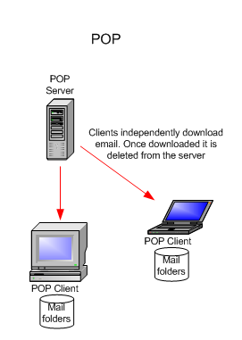
Model:
Vehicle Classification
The Xception model serves as the base for feature extraction. It is a deep convolutional neural network known for its exceptional performance in image classification tasks
Model Architecture
The model architecture is based on the Xception pre-trained model, with additional dense layers for classification. The key layers in the model include:
Xception Base: Utilizing pre-trained weights on ImageNet for feature extraction.
Global Average Pooling: Reducing spatial dimensions and aggregating features.
Dense Layers: Multiple fully connected layers for further feature transformation and abstraction.
Dropout: Regularization technique to prevent overfitting.
Output Layer: Softmax activation for multi-class classification.
4

Slide 5
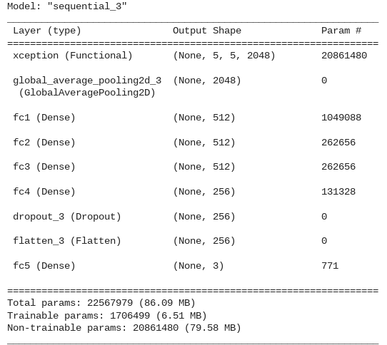
Model Cont..
Vehicle Classification
Model Summary:
The summary of the model provides a concise overview of its architecture, layer types, output shapes, and parameters. The Xception base model typically contributes a large number of parameters, especially when frozen during training.
Model Training:
Training is conducted for 10 epochs using the training set,
and the model’s performance is evaluated on the
validation set.
5

Slide 6
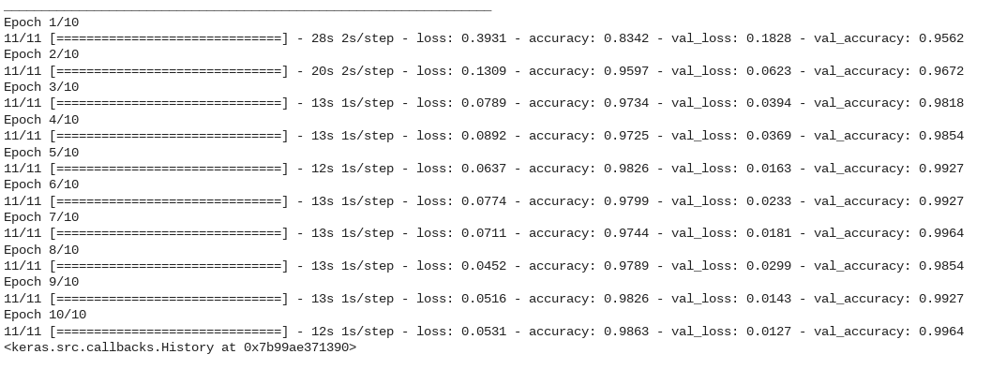
Model Cont..
Vehicle Classification
Model Training
6

Slide 7
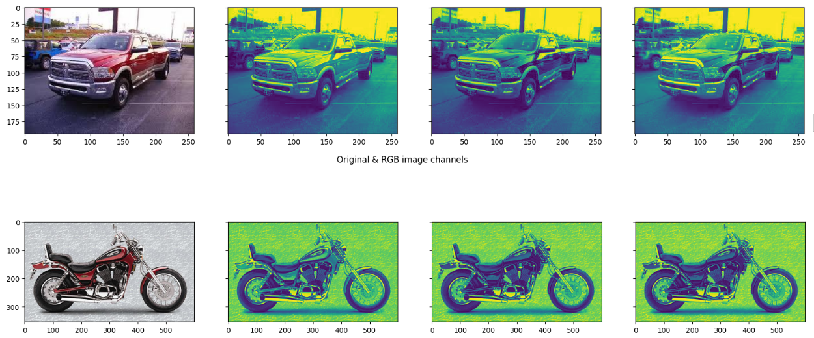
Functionality:
Vehicle Classification
Image Visualization
To gain insights into the dataset, images from each class are visualized.
Displays original images alongside their RGB channels.
7

Slide 8
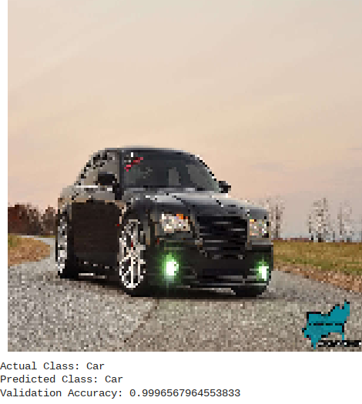
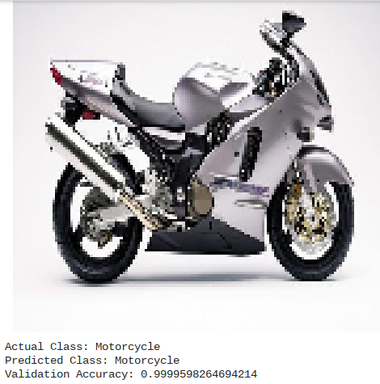
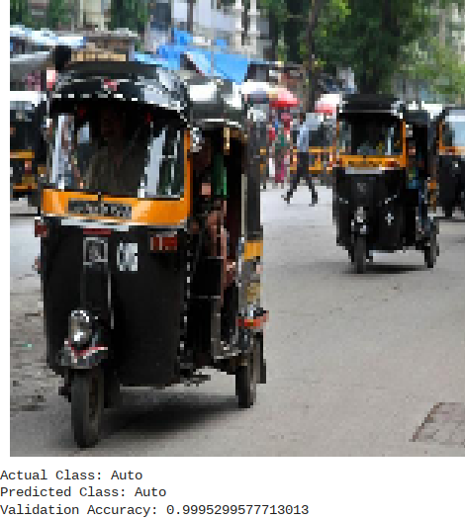
Functionality Cont..
Vehicle Classification
Model Evaluation
The load_and_predict function is introduced to facilitate individual predictions.
This function loads an image, preprocesses it, and predicts its class using the trained model.
Example usage with test images demonstrates the functionality and accuracy of the model.
8

Slide 9
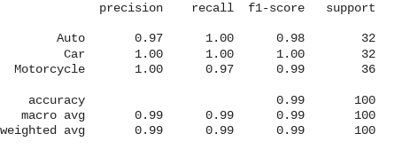
Functionality Cont..
Vehicle Classification
Model Evaluation Metrics
A comprehensive classification report is generated to provide detailed metrics on model performance.
Metrics include accuracy, precision, recall, and F1 score, offering a nuanced understanding of the model's proficiency across different classes.
9

Slide 10
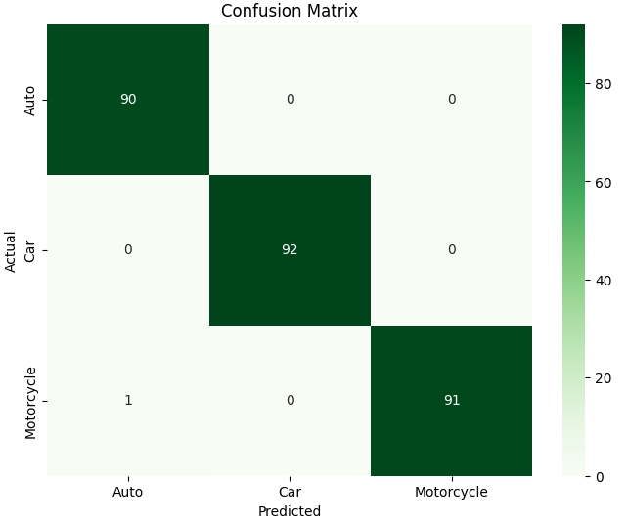
Results:
Vehicle Classification
Confusion Matrix
A confusion matrix is presented to visually represent the model's predictions against ground truth labels.
This matrix provides insights into the model's strengths and weaknesses, highlighting areas for improvement.
10

Slide 11
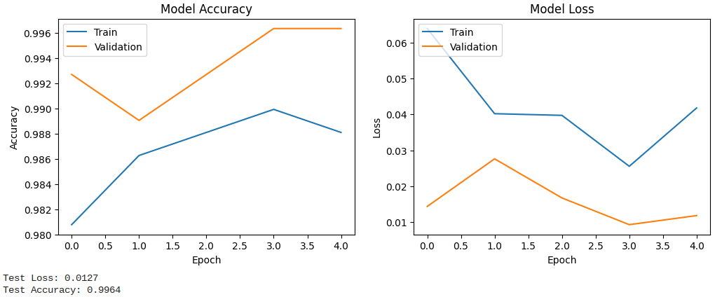
Results Cont..
Vehicle Classification
Training & Test Set Evaluation:
The model is evaluated on a tarin and test set.
Train and Test accuracy and loss are displayed.
11

Slide 12

Vehicle Classification
12

